Slide 1
I used to …. live in California make cakes for friends study Russian. work with an architect. be lazy.
Basic 12

Slide 2
Past with Used To
Use used to + base form to show habitual events that were true in the past but not today.
She used to be on the editorial staff of a Chilean magazine called Paula.
She used to write many humorous and feminist articles for that magazine.
now
past
future

Slide 3
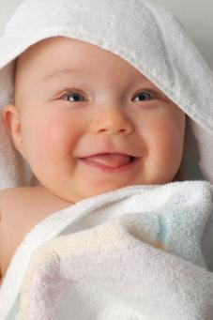
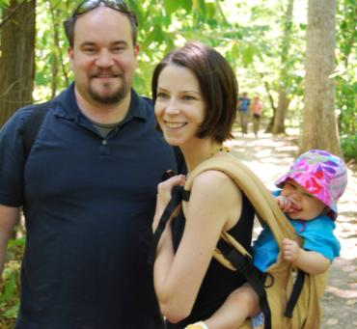
2-11 EXPRESSING PAST HABIT: USED TO
He used to be a baby, but now he is man with a family.

Slide 4
2-11 EXPRESSING PAST HABIT: USED TO
(a) I used to swim every afternoon.
Now I work in the afternoon.
(b) Fatima used to play piano, but now
she plays the violin.
(c) Jasmine used to laugh, but she doesn’t anymore.
used to past situations
no longer exist
used to + simple form of a verb

Slide 5
2-11 EXPRESSING PAST HABIT: USED TO
(d) Did you use to swim every afternoon?
did + subject + use to ?

Slide 6
2-11 EXPRESSING PAST HABIT: USED TO
(e) I didn’t use to swim every day, but
now I swim every afternoon.
(f) Fatima never used to love school, but now she loves it.
For negative ideas,
never is possible too.

Slide 7
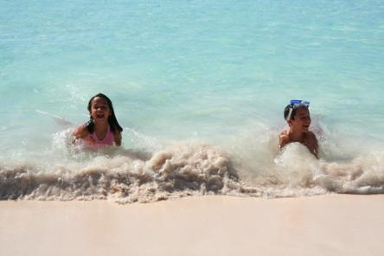
2-11 Let’s Practice
Correct?
The children used to swam in the ocean.

Slide 8
2-11 Let’s Practice
Correct?
No
The children used to swam in the ocean.
The children used to swim in the ocean.

Slide 9

2-11 Let’s Practice
Correct?
Were you use to ask questions in school?

Slide 10
2-11 Let’s Practice
Correct?
No
Were you use to ask questions in school?
Did you use to ask questions in school?

